Slide 1

Welcome to Providence Health Plan’s presentation on your benefits
Available January 1 of 2024

Slide 2
What’s new for 2024
No changes to deductibles, copays, and coinsurance
Medical Plan Updates
Choice Plan
  Referral no longer required to see a specialist
Statewide Plan
  Massage Therapy benefit added. 15% coinsurance after deductible. $1,000 annual benefit
Providence Updates
  Increasing Behavioral Health Virtual Solutions - Focused on broad access and additional specialty support.
    Talkspace: telehealth provider of virtual psychotherapy for adults and teens 13+, and available through text, voice, or video options.
    Equip: virtual, eating disorder treatment for kids and young adults ages 6-24 using Family Based Treatment (FBT).
    Charlie Health: Intensive Outpatient Program (IOP) delivered virtually and available 24/7 for teens and young adults ages 11-30

Slide 3
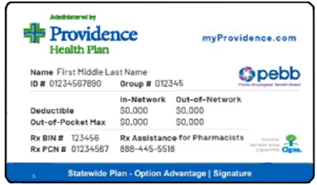
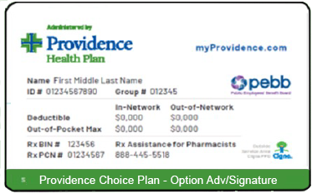
Your Providence health plan options
OPTION 1: PEBB Providence Statewide OPTION 2: PEBB Providence Choice
Pay more for flexibility
OHSU and Adventist in-network
No referrals required
Self-directed care
Massage therapy covered
Pay less for predictability
Medical home care team
No referrals required
Low copayments
Massage therapy covered

Slide 4
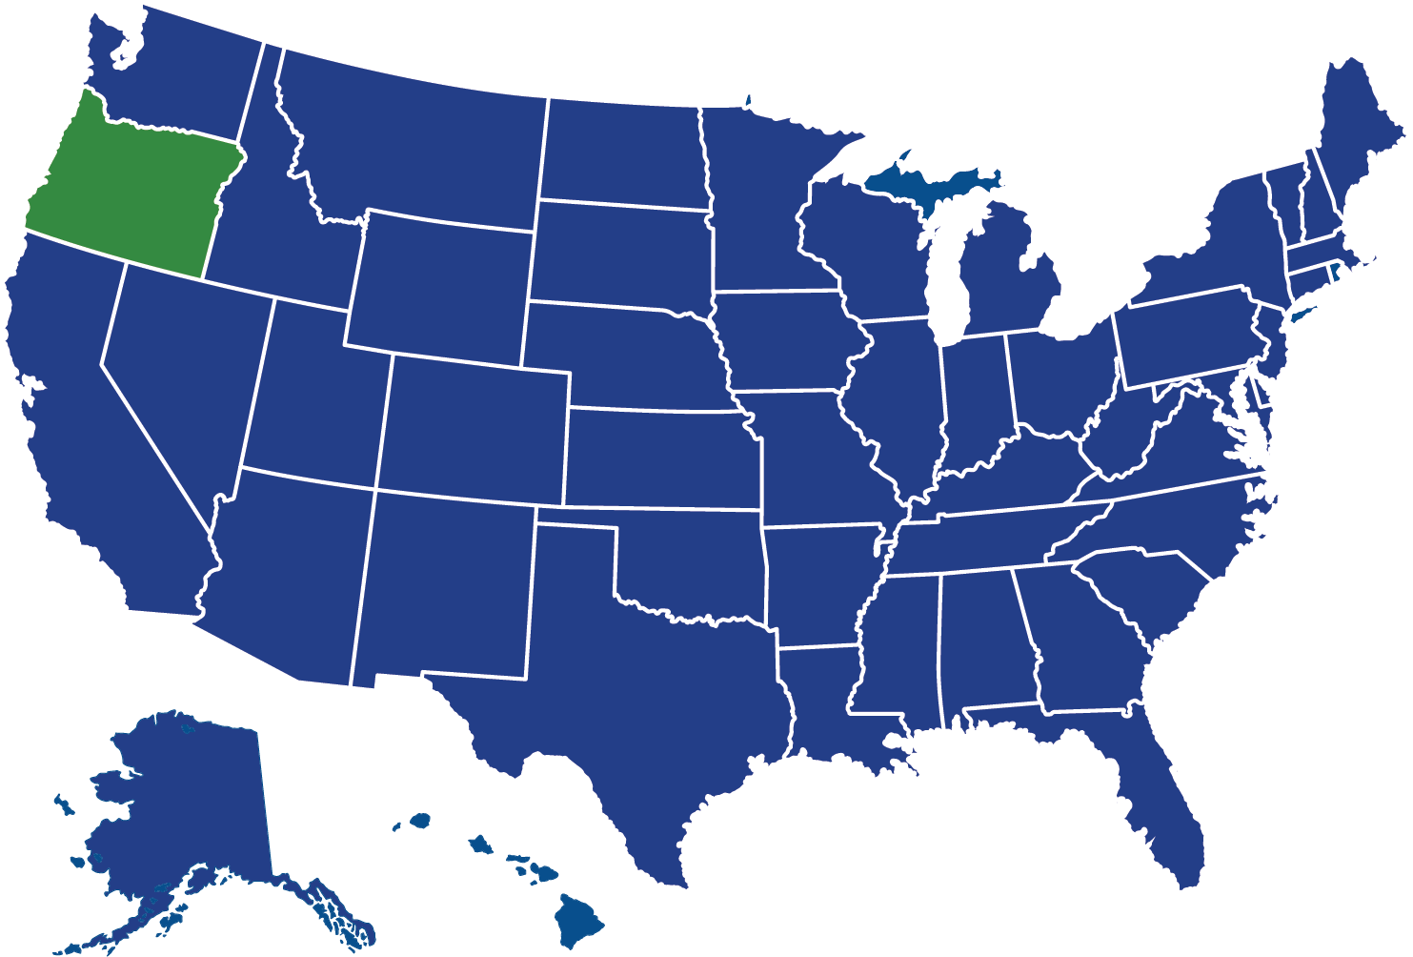
Providence Statewide network
Providence Statewide offers a coast-to-coast network of providers including OHSU, Providence and Adventist healthcare systems
Self-directed open access to over 1 million providers nationwide
Coverage for medically necessary services when traveling internationally
No referral requirement
Cigna Network Providence Proprietary Network

Slide 5
Providence Choice network
Providence Choice network offers approximately 400 patient-centered medical homes throughout Oregon and SW Washington
Access to over 1 million providers nationwide
Urgent and emergency services covered when traveling
No referrals required
Coordinated Care Plan
Cigna Network Providence Proprietary Network

Slide 6
Providence Choice
As a Providence Choice member, you will be required to choose a medical home.
Before you receive health care services and schedule an appointment:
  Communicate your selection to Providence via one of the following options:
    myProvidence account
      Choose “Medical Home Selection” under the “My Providers” drop down in the top navigation bar.
      Review your options, then click on the “set As A Medical Home Clinic” button.
    Customer service
      We’re here to help! (503) 574-7500 or 800 878-4445 (TTY: 711) from 8AM to 5PM (Pacific Time), Monday through Friday.
PEBB Providence Choice

Slide 7

2024 Medical and Prescription Plan Overview

Slide 8

Advancing health equity for all
Our vision, Health for a Better World, is driven by a belief that health is a human right. Every person deserves the chance to live their healthiest life.
At Providence, we recognize that long-standing inequities and systemic injustices exist in the world. This has led to health disparities among communities that have been marginalized because of their race, ethnicity, gender, sexual orientation, age, ability, religion or socioeconomic status.
Each year, we serve more than 6 million people of every walk of life. We value each member of our diverse communities for their identities, journeys and experiences. We promise to strengthen the diverse communities we serve, inclusive of those who identify as LGBTQIA+. Our commitment is to welcome all and treat one another with respect and dignity.

Slide 9
Cost share overview – no changes in 2024!
Benefit summaries may be found online at: www.providencehealthplan.com/pebb
PEBB STATEWIDE PPO
Calendar year deductible |  | Cost Share (after deductible, if applicable) |  | Calendar year Out-of-pocket maximum
In-Network | Out-of-network | In-network | Out-of-network | In-Network | Out-of-network
$250 / person $750 / family | $500 / person $1,500 / family | 15% | 30% | $1,900 / person $5,700 / family | $4,800 / person $14,400 / family
Any portion of the medical deductible met in the 4th quarter of the year applies to the next year’s deductible
PROVIDENCE CHOICE
Calendar year deductible |  | Cost Share (after deductible, if applicable) |  | Calendar year Out-of-pocket maximum
Medical Home | Out-of-Medical Home | Medical Home | Out-of-Medical Home | Medical Home | Out-of-Medical Home
$250 / person $750 / family | $500 / person $1,500 / family | $10 per visit | 30% | $1,500 / person $4,500 / family | $4,000 / person $12,000 / family

Slide 10

Prescription drug coverage
Prescription drug benefits do not apply to medical deductible or medical out-of-pocket maximum
PEBB’s Value Formulary includes a list of medications that are covered in full
Copay or Coinsurance
Drug Coverage Category | All participating & preferred retail pharmacies (up to a 30-day supply) | All mail order & preferred retail pharmacies (up to a 90-day supply of maintenance prescriptions) | All participating specialty pharmacies (up to a 30-day supply of specialty drugs) | Calendar year deductible | Calendar year out-of-pocket maximum
Value Drug | Covered in full | Covered in full | Does not apply | Does not apply
Generic drug | $10 | $25 | $100
Brand name drug | $30 | $75 | $100
$1,000 per person
$3,000 per family
(3 or more)
$50 per person
$150 per family
(3 or more)
PEBB’s prescription drug lists (formularies) are available online: www.ProvidenceHealthPlan.com/PEBB

Slide 11

Providence Behavioral Health
We're here for you when you need us.
Enhanced behavioral health and substance use services to simplify the way you get whole self-care
24/7 access to a crisis-trained behavioral health and substance use service support team
Help is available 24 hours per day, 7 days per week:
Call us 503-574-7500 or 800-878-4445
Find your behavioral health providers
Visit providencehealthplan.com/findaprovider

Slide 12

Behavioral Health Concierge
Virtual behavioral health visits at no cost to PEBB members
Schedule same-day or next-day access to virtual counseling
Access appointments with a licensed counselor from 7AM to 8PM (Pacific Time)
Available for all PEBB members in Oregon, Washington, Idaho, Montana, California, and Texas Call: 877-744-9355
Learn more about behavioral health concierge
ProvidenceHealthPlan.com/BehavioralHealth

Slide 13
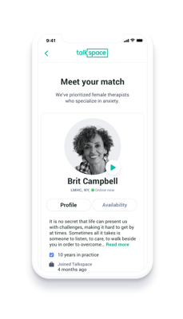

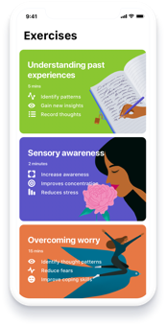
Talkspace is the leading virtual behavioral health care provider for mild to moderate needs
Therapy | Psychiatry | Self-Help Tools
Dedicated behavioral health and emotional well-being support from a licensed clinician
Evaluation, prescription, and medication management from a licensed prescriber
Exercises, such as meditation and journaling, are available to use anytime

Slide 14
Online resources and tools

Slide 15
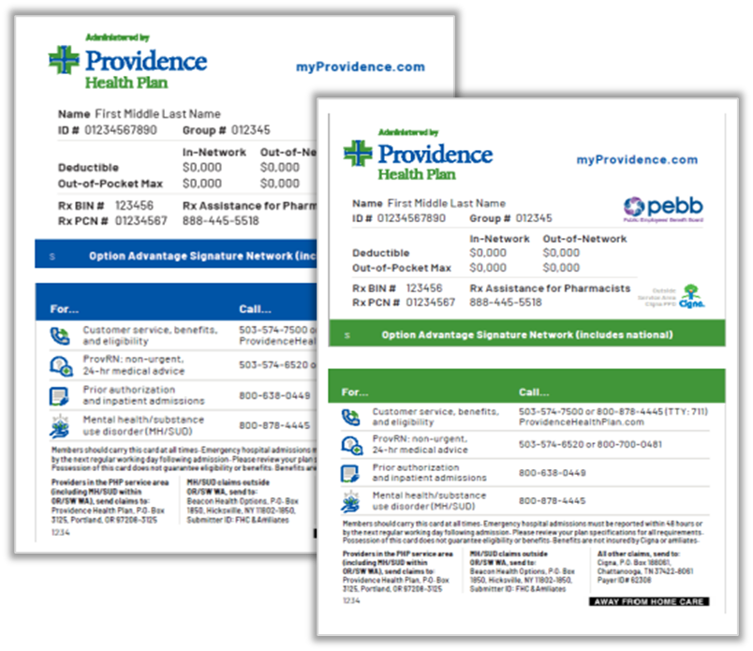
ID cards – printable ID cards
Access ID cards via MyProvidence
Subscriber and spouse/partner may also choose to print a PDF version of the ID card for themselves or individual dependents
Everyone can access

Slide 16

Resources on the web
Tools available on our website include:
  myProvidence, secure member portal
  Pharmacy resources
  Searchable Provider Directory
  Numerous wellness tools & resources
  Behavioral Health Concierge
  Kaia Health digital pain management program
  Virta Health Type 2 diabetes reversal program
  Omada Type 2 diabetes prevention program
  Talkspace - Virtual behavioral health benefits
→Get Started
Go to www.providencehealthplan.com/pebb to explore the tools and resources available to you online.

Slide 17
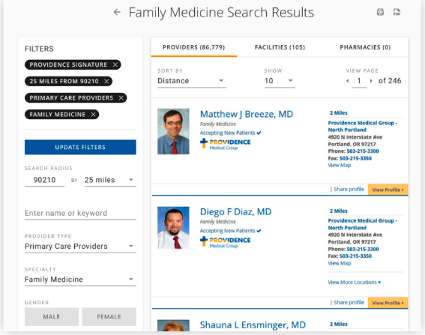
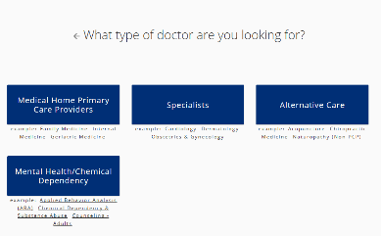
Navigating the Providence directory
1
Visit providencehealthplan.com/findaprovider
2
Search by member ID or plan type and network
3
Tailor your search by provider, place, name, keyword or location
4
Customize results based on preferences — specialty, location, gender, language

Slide 18
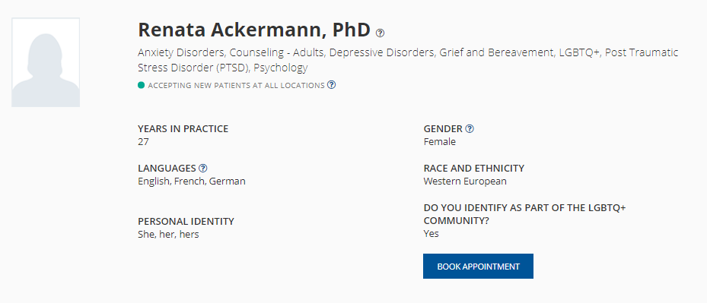
Find the best provider for you
Providers Race & Ethnicity
Providers Personal Identity, pronouns
Does the provider identify as part of the LBGTQIA+ Community
Visit providencehealthplan.com/findaprovider

Slide 19

Express care virtual visits
See a provider in minutes, from anywhere
  Live video visits from your smartphone, tablet or computer
  No appointment necessary
  Board-certified providers treat many common conditions such as cough, cold/flu, sinus/ear/eye infections, etc.
Extended hours
  8am to 8pm in OR, WA, MT, AK, CA and 24/7 nationwide through our network partner
No Cost Option for Care
  Free for PEBB members
  Visit information is shared with PCP for care continuity support

Slide 20
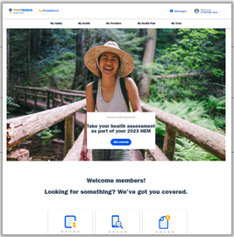






myProvidence
Connect to
your personal
health plan information
Access exclusive
member discounts on fitness memberships, travel and more
Take a personal health assessment to find out what
you’re doing well and where you can improve
Easily manage
your health plan
with user preferences
Estimate the cost of
care or prescriptions before you receive them
Visit Wellness Central,
a personal health and wellness hub to track
your health goals
→Get Started
Sign up for your account at myProvidence.com
Don’t forget HEM
September 1st through October 31st

Slide 21
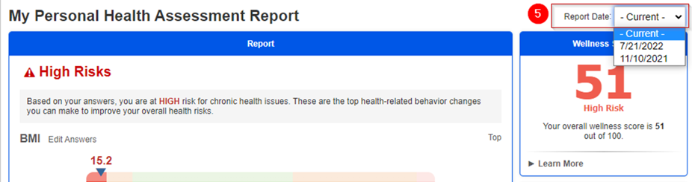
Wellness assessment (HEM)
Employees answer health and lifestyle questions
Approximately 10 minutes to complete
Member receives personalized recommendations with areas to focus on, an overall wellness score, and a detailed personal health analysis, lifestyle risks and health conditions, programs and tools to achieve health goals
General health
Preventive health
Nutrition
Physical activity
Mental and emotional health
Safety
Tobacco and alcohol
Readiness to change
Productivity
This information is NOT shared
with PEBB or your employer!
Don’t forget HEM
September 1st through October 31st

Slide 22
Additional member well-being resources

Slide 23
Member well-being resources
At Providence, we value whole self-care for all members. We offer resources across the behavioral health continuum, so members and their families can get the care they need.
Mental Health Education Tools | Resources to Relax & Recharge | Stress Management Health Coaching | Learn to Live | Behavioral Health Concierge | Broad Behavioral Health Network | 24/7 Crisis Line
Learn about the signs, symptoms and treatments for mental health conditions | Save on massage therapy, yoga, meditation and more through LifeBalance and ChooseHealthy | Get one-on-one support to reduce stress or just feel better every day | Enroll in a digital program to learn to overcome stress, anxiety, depression, insomnia, and substance use | Access virtual and confidential same-day or next-day appointments at no cost | Find a provider you trust and make an in-person or virtual appointment, no referral required | Get behavioral health and substance abuse service support right away from our crisis-trained staff
Low severity
Moderate severity
High severity

Slide 24


Health coaching
Standard health coaching program
    Guidance to help members identify and take action toward healthier lifestyle and behavior choices
      Empower members to lose weight, improve diet, manage stress, exercise or stop using tobacco
    Evidence-based coaching techniques
    Sessions are 1:1

Slide 25

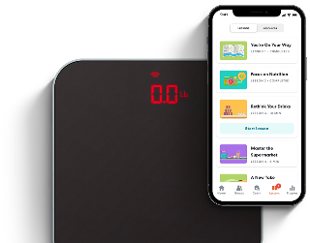
Omada for diabetes prevention
Members get pre-connected cellular scales to report data and track progress in real time
Omada care teams receive automatic updates and provide relevant, evidence-based guidance
Personal health coaches and specialists update best clinical practices for each member based on data points
  19% of participants lost 5% or more of their initial weight
  58% of participants achieved normal A1C at 12 months in the program

Slide 26
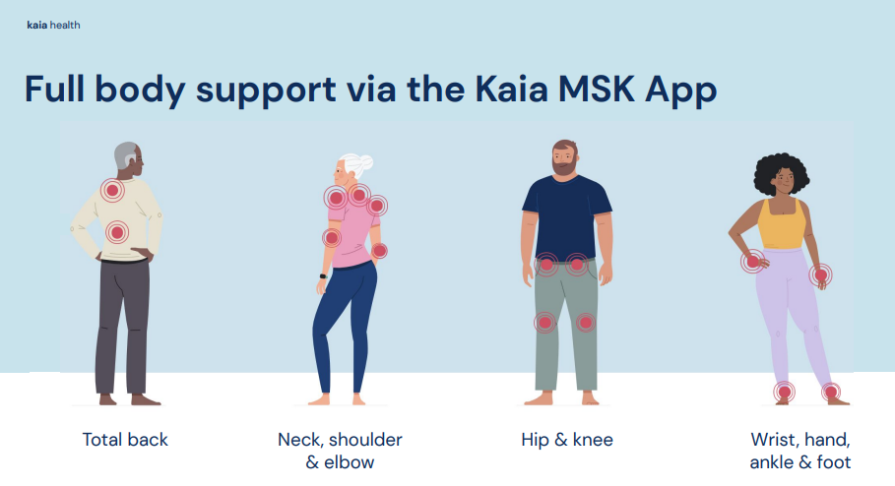

Kaia Health digital pain management
Kaia helps you fight aches and pains, in as little as 15 minutes per day
  Ready when you are! No equipment or wearables needed
  Direct audio and video feedback on how you are performing your exercises by Kaia’s Motion Coach™
    Real time feedback ensures good form & optimal results
    Clinically validated -- feedback as effective as in-person PT
  Kaia is designed to fit into your lifestyle and is available 24/7 from the comfort of your own home

Slide 27
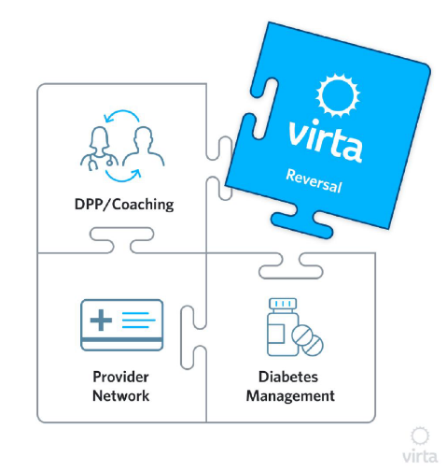
Virta Health type 2 diabetes reversal
Virta helps to naturally reverse type 2 diabetes
Virta is a non-surgical, medical treatment that is clinically proven to reverse Type 2 diabetes
  Lower blood sugar and lose weight while eliminating the need for medications
PEBB members currently living with type 2 diabetes may be eligible to enroll in Virta Health at NO COST
To learn more, visit www.virtahealth.com

Slide 28






Get the right care at the right time in the right place
ProvRN
Free
    Connect with a registered nurse 24/7
    Easy first step when you have symptoms and want to know if you need face-to-face care
ExpressCare Virtual
Free
    Talk with a provider from anywhere using your tablet, smartphone, or computer
    Available nationwide
ExpressCare
Clinics
Free
    Same-day, in-person treatment
    With many convenient locations (some in your local Walgreens), it’s easy to find a clinic near you
Primary Care
$
    Your primary healthcare partner for check-ups, managing chronic conditions, and specialist referrals
    Appointment required
Urgent Care
$$
    When you need help right away and can’t wait for an appointment
    Hours vary by location
Emergency
$$$
    When you think you may be in danger
    Available 24/7
If you ever think your life or well-being could be in serious danger, call 911 immediately.

Slide 29








Member support and navigation
Providence Pathfinder
  Single point of access for medical, behavioral health, and pharmacy benefit support
  24/7, 365 access to a crisis-trained support team
  Secure chat and email via MyProvidence, with history stored in the member’s account
24/7, 365 access to commonly requested services
  Real time benefits, cost share details, PA and referral information, and ID card requests
Identifying & resolving
Barriers to care
Personalized support for benefits,
claims cost, & coverage.
Guided introduction to
Telehealth & virtual care
Guided introduction to
telehealth & virtual care
Providence
Member
Easy Access
Pathfinder + True
Health Guides
Extensive behavioral health
Support trained in crisis care
Highly skilled care teams for
complex healthcare support

Slide 30
Get answers to your health plan questions
Online: www.ProvidenceHealthPlan.com/PEBB
PHONE: 503-574-7500 or 800-878-4445 (TTY: 711) Customer Service is available 8 a.m. to 5 p.m. (Pacific Time) Monday through Friday
SECURE EMAIL AND CHAT: myprovidence.com

Slide 31
www.ProvidenceHealthPlan.com/PEBB
Complete the health assessment at myProvidence.com by October 31st
Enroll in Providence Statewide or Providence Choice by October 31st

